Slide 1
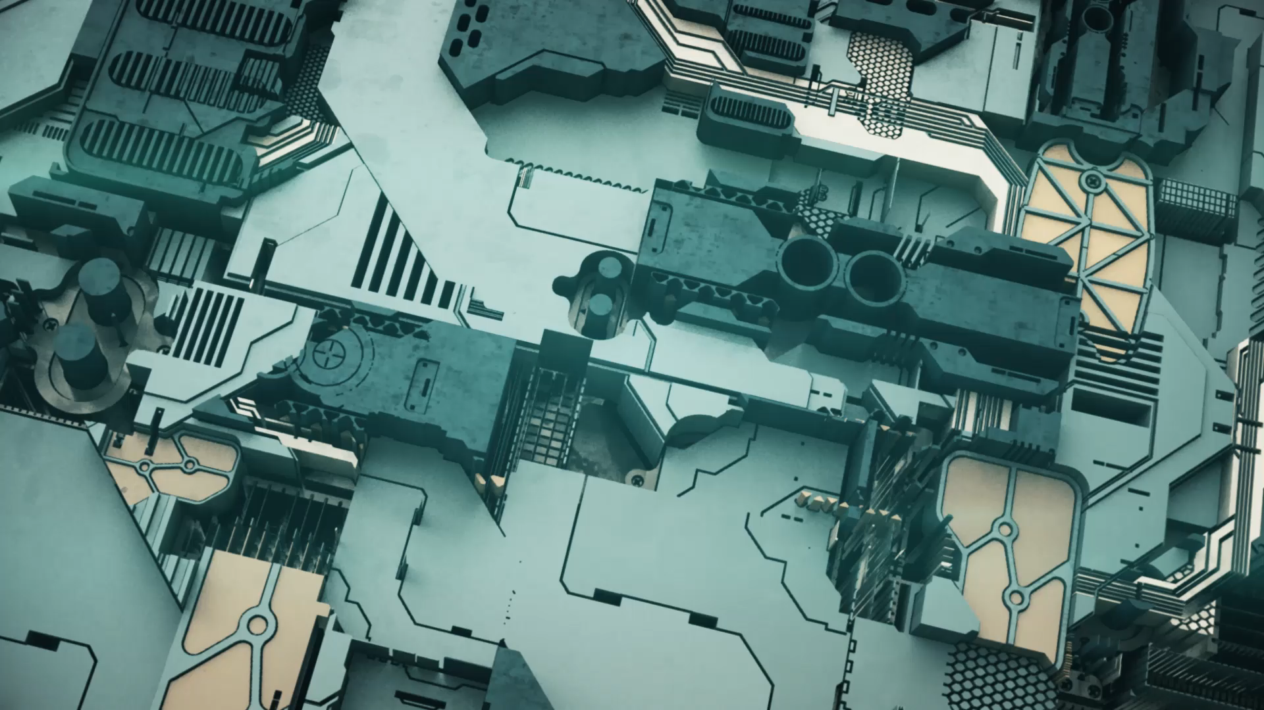
Algorithms for Landing on PLANETS
TY-ICC-B2 Group 2 Course Seminar

Slide 2
Agenda
Interplanetary Travel & Landing a rover
Approach Trajectories
Guidance Navigation & Control
Gravity Turn
Mars Science Laboratory (MSL)
Polynomial Guidance & The Landing Ellipse
Pinpoint Landing

Slide 3
Space & Interplanetary Travel
First space travel: on 3rd November 1957
Lunokhod 1 landed on the moon 13 years later, in November 1970.
Arising Questions:
How does a robotic spacecraft land on other planetary bodies?
How do you design the algorithms that govern the descent of the rover?

Slide 4
Landing a Rover
Trajectory planning in real time in a harsh autonomous environment is not a trivial task.
Problems:
Tight computational resource availability
Computational resource spread across various tasks

Slide 5
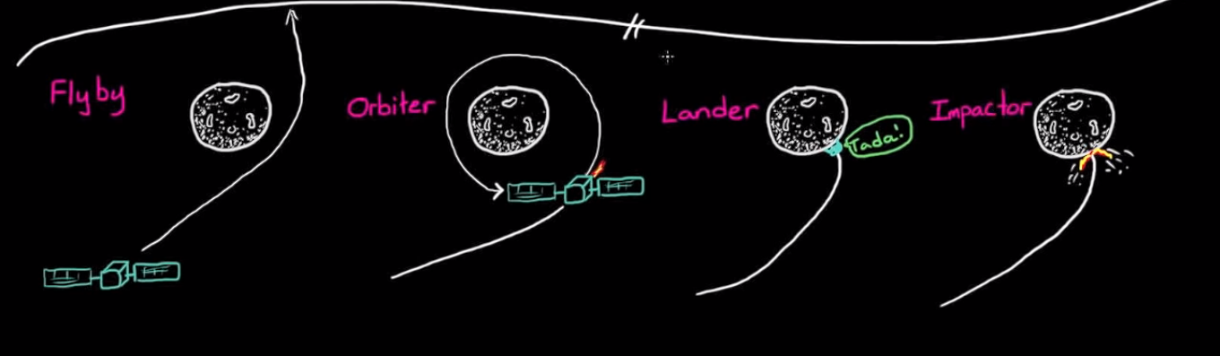
Approach Trajectories^{[2]}
Once spacecraft is near destination, there are four approach trajectories:

Slide 6
Guidance Navigation & Control^{[1]}
Interplanetary spacecrafts can travel up to 160,000 km/hr relative to the sun.
Guidance Navigation & Control system responsible for soft landing
If GNC fails, a soft lander becomes impactor.
Note that, spacecraft does not mind where they land, just that they land.
Thus, it is a Powered Descent Guidance problem.

Slide 7
Powered Descent Guidance
Two point boundary value problem
Boundary point 1: certain altitude & velocity.
Boundary point 2: at surface, landed safely
Whatever you do between these two points is the algorithm you choose.

Slide 8
Gravity Turn^{[2]}
One of the simplest soft landing algorithms
Used on Surveyor, first American soft lander, 1966.
Algorithm: Fire the thruster, in the direction of the velocity vector
Accomplishes Two Tasks:
Horizontal velocity becomes 0
Further descent straightens out the aircraft.

Slide 9
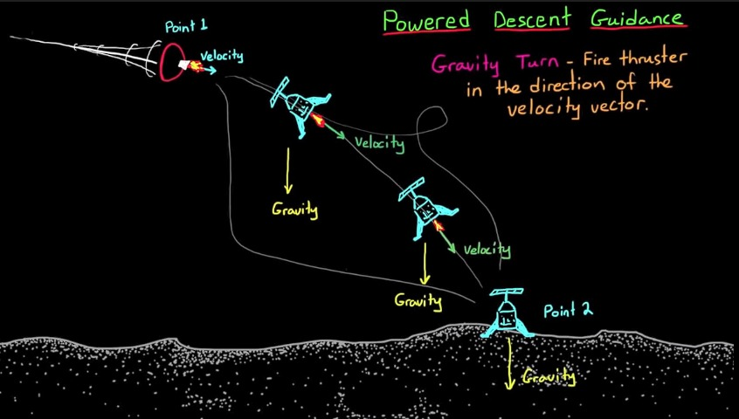

Slide 10
Gravity Turn^{[4]}
First, measure velocity of spacecraft with respect to planet
Then, use a controller to orient spacecraft to oppose that velocity.
But, how much thrust to use?
Too much thrust: Zero velocity well above the surface
Too little thrust: Crash landing

Slide 11
The Second Controller^{[4]}
So one controller monitors velocity & adjusts orientation,
Another controller will be governing the velocity you will be going at a specific altitude, by adjusting the thrust.

Slide 12
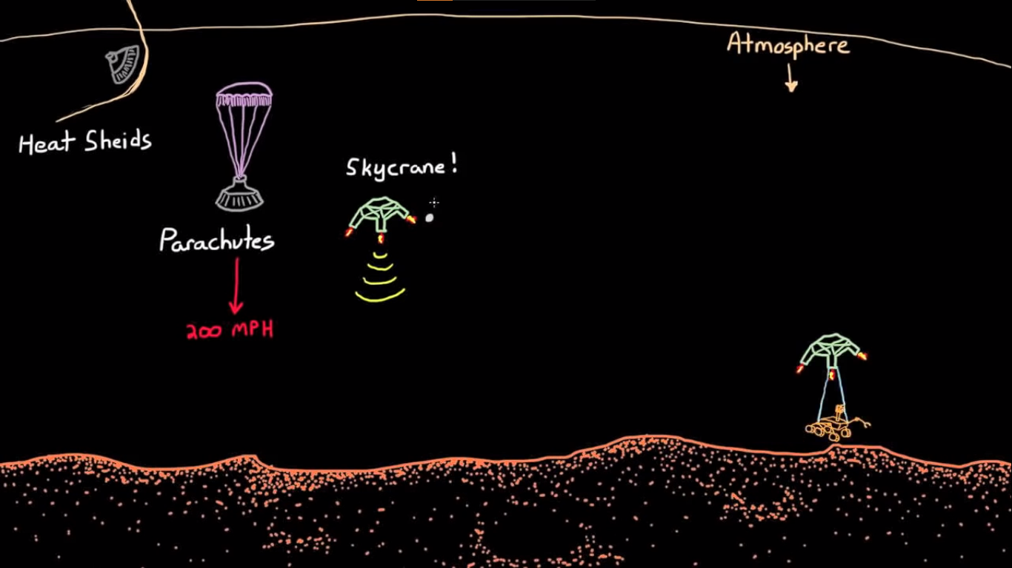
The Mars Science Laboratory (MSL)^{[2]}
Mission by NASA in 2011, which carried the rover Curiosity.
Seven minutes of terror: Entry, Descent and Landing (EDL) phase of the rover
First, Martian atmosphere leveraged to orient & reduce speed of the aircraft, first using heat shields & then parachutes.
EDL Team created the SkyCrane to perform soft landing

Slide 13
Polynomial Guidance
Back to Boundary Problem, but with lower initial speed.
MSL used Polynomial Guidance, instead of Gravity turn
Create a polynomial joining the two boundaries
Generate a thrust profile, to keep the SkyCrane following that polynomial
Benefit: Better control over fuel consumption
Drawback: Can’t land at a specific place

Slide 14
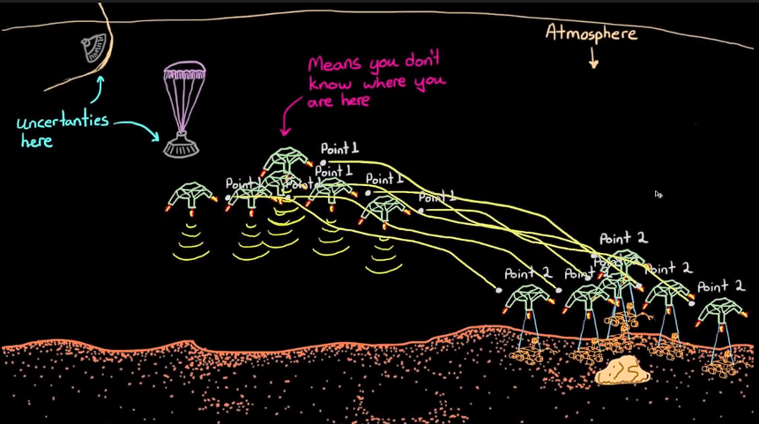
Uncertainties in position
Small uncertainties in speed, position, atmospheric density at the beginning of the descent of spacecraft.
Thus the end boundary point is not a singular point, but rather a range of locations, called the landing ellipse.

Slide 15
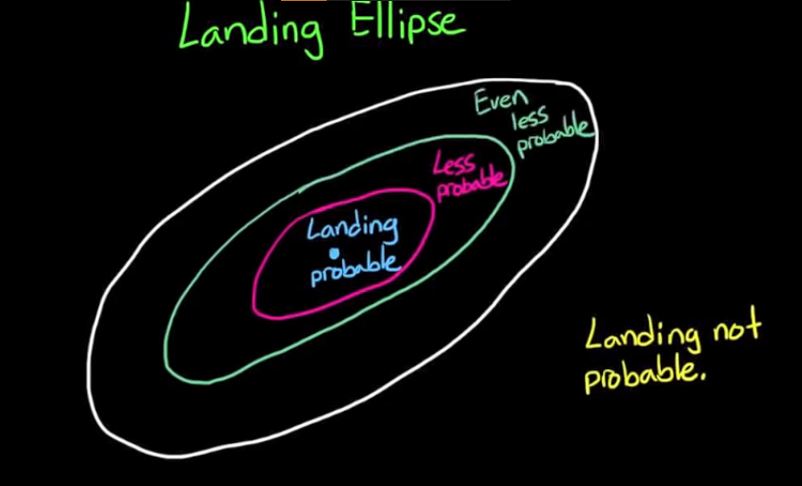
The Landing Ellipse

Slide 16
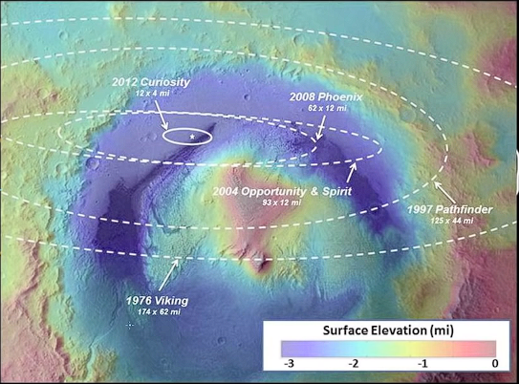
With practice, the size of the landing ellipse decreases.
Drawback: The ellipse can be minimised, but can never be zero

Slide 17
Pinpoint Landing ^{[4][5]}
Being able to land at an exact location has advantages
Avoid obstacles like rocks
Land at particular areas of interest
So how to guarantee that you land on a target?
Spacecraft needs to constantly correct it’s velocity & position as it descends

Slide 18
Pinpoint landing^{[4][5]}
Pinpoint landing has never been done on extra-terrestrial environment.
Spacecraft cannot choose any path to reach from current position to the target position, it needs to choose path which follows certain constraints such as:
Following a particular sensor direction
Glide slope angle not being too steep, among others
While still minimizing fuel usage.
This makes it difficult to compute in real time.

Slide 19
Falcon 9 & Pinpoint landing^{[5]}
SpaceX’s Falcon 9 has successfully achieved pinpoint landing on Earth up to an accuracy of 10m.
The booster contains high precision GPS, gyroscopes, and accelerometers at both top and bottom ends to precisely interpolate the booster orientation, position, and velocity. The booster also contains a huge number of strain gauges that monitor forces on the structure at crucial locations, especially engine thrust.
All of these data inputs are timestamped so the three-way redundant computers can calculate where the booster was microseconds ago. By comparing the past position and vector to the desired course, the latest navigation error is calculated.

Slide 20
Conclusion
Gravity Turn, Polynomial Guidance & Pinpoint landing are techniques to solve the problem of soft landing.
Gravity turn is a rudimentary yet useful method, but has no control over landing spot.
Polynomial Guidance is more sophisticated, but the landing spot is still unknown, spread over an elliptical area.
Pinpoint landing on extra-terrestrial environments is a problem that is being researched
Pinpoint landing, especially on non atmosphere based environments is almost certainly going to take help of vision based systems.

Slide 21
References
^{[1]}Surveyor Program Results,1969
^{[2]}"Curiosity relies on untried 'sky crane' for Mars descent". Spaceflight Now. July 31, 2012.
^{[3]}"Final Minutes of Curiosity's Arrival at Mars". NASA/JPL.
^{[4]}"Mars Science Laboratory: Mission". NASA/JPL.
^{[5]}Douglas, B, “How to Land on a Planet (and how it'll be done in the future)”

Slide 22
Thank You
Guide: Prof. Sanika Patankar
Group No. 2
Aditya Rotithor (27)
Adarsha Sapkal (32)
Shaunak Deshpande (37)
Shrawani Shinde (46)

